Slide 1


Tellegen’s Theorem
Proof:
Choose a reference node and construct the node matrix A. Then

Slide 2
Note that in Tellegen’s Theorem v and i seem unrelated:
v is a possible solution for voltages and i is a possible solution for currents.
They don’t have to exist together in the circuit. In other words, if
v’ and v’’ satisfy KVL, i’ and i’’ satisfy KCL, then
If v and i are solutions of the same circuit then Tellegen Theorem implies
....................................................................................................................

Slide 3
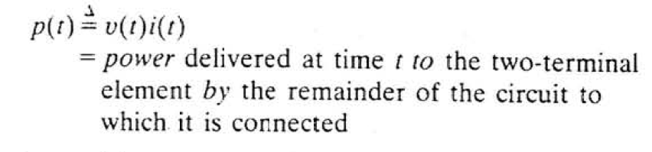
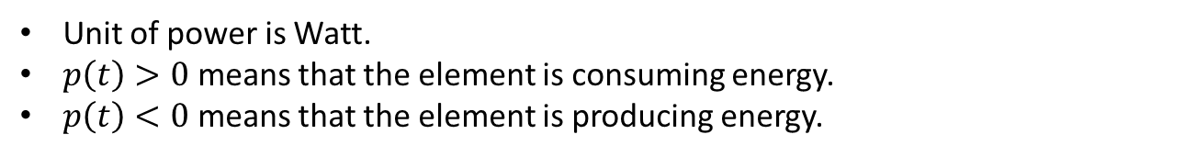
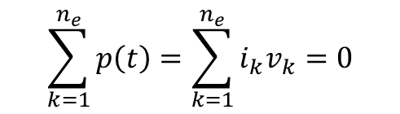
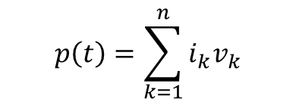
Instantaneous Power (Anlık Güç)
Instantaneous power for a 2-terminal element:
Unit of power is Watt.
$p\left(t\right)>0$ means that the element is consuming energy.
$p\left(t\right)<0$ means that the element is producing energy.
$$p\left(t\right)=\sum_{k=1}^{n}{i_{k}v_{k}}$$
Instantaneous power for an (n+1)-terminal or n-port element:
$$\sum_{k=1}^{n_{e}}{p\left(t\right)}=\sum_{k=1}^{n_{e}}{i_{k}v_{k}}=0$$
Total instantaneous power for a circuit:
Tellegen’s Theorem

Slide 4
1
a) v₂=2V, v₄=4V, v₆=6V, v₇=7V, v₈=8V are given. Find the other voltages.
b) i₁=1A, i₃=3A, i₅=5A, i₉=9A are given. Find the other currents.
c) Show that Tellegen’s Theorem is satisfied for this circuit.
2
3
1
4
2
3
5
6
4
7
9
8
5
6

Slide 5
How many linearly independent equation can we obtain from KVL and KCL?
How many unknowns are there?
How many equations do we need?
How can we obtain the other ...... equations?

Slide 6
Element Equations
for 2-terminal elements
v
i
resistor
capacitor
inductor
memristor
q
Ø
Resistor: An element that has an algebraic equation between v and i.
Inductor: An element that has an algebraic equation between Ø and i.
Capacitor: An element that has an algebraic equation between v and q.
Memristor: An element that has an algebraic equation between Ø and q.
Algebraic equation: ....................................................................

Slide 7
2-Terminal Resistors
Linear Resistor
+
resistance, ohm
conductance, siemens
mho
v
-
i-v characteristic
v-i characteristic
Instantaneous power of a linear resistor:

Slide 8
2-Terminal Resistors
If R>0, then , passive resistor,
consumes energy.
If R<0, then , active resistor,
produces energy.
i-v characteristic
i-v characteristic
passive resistor
active resistor

